Slide 1

Mini Project Attendance Automation Using Facial Recognition

Slide 2
Problem Statement
Build an Attendance Automation System Using Facial Recognition

Slide 3
Introduction
This project will involve developing a program that uses the face_recognition and CV2 libraries to identify faces and mark students' attendance, a program that takes pictures of people and adds their name and face encodings to a database file, and a user interface (UI) that launches a Tkinter window.
The following buttons on the Tkinter window connect to the programs that indicate attendance and add faces to the database.
The program "Mark Attendance" opens a window displaying the camera feed. It first identifies a face in the feed, then searches data.txt for encodings that correspond to the face. If any of the encodings match the face in the camera frame, the program marks the student's attendance in a CSV file dated that particular date.
Add Face To Database Program: This program will launch a basic Tkinter interface with a Name Entry for entering the name and a button that will launch a second window displaying the camera feed. It then records ten frames per interval, stores the images in a directory, and encodes the images into a file.

Slide 4


Methodologies (Block Diagram)
User Interface
Add Face
Mark Attendance
Exit
Capture Faces
Read Face
Close all the windows
Encode them
Compare it to File
Store them in a File
Mark the Attendance

Slide 5
Methodologies
Save as CSV:
Names, time, and date of attendance are saved to a CSV file by the save_to_csv function. To prevent duplicate entries, it looks for dates that already exist in the CSV file.
Read Encodings from CSV File:
Face encodings can be read from a CSV file using the read_encodings_from_csv function. The first element in each row in the CSV file is the person's name, while the other elements are face encodings.

Slide 6
Methodologies
Utilize Face Recognition to Record Attendance:
Face recognition is used by the mark_attendance_with_face_recognition function to mark attendance. It uses OpenCV (cv2.VideoCapture) to record video frames from a webcam, the face_recognition library to identify faces, and a comparison with known face encodings. If a match is discovered, the individual's name is noted, and real-time attendance is noted on the video feed. The save_to_csv function is also used to save the attendance data to a CSV file. The application calls mark_attendance_with_face_recognition and gives the paths to the CSV file and destination directory in the __main__ block. This implies that the script will use facial recognition to record attendance when it is executed directly.
Loop and User Communication:
Until the user chooses to stop it, the script will keep capturing and processing video frames in an endless loop. The 'q' key closes the OpenCV window, exits the loop, and releases the resources used for video capture.

Slide 7
Methodologies
Configurations for Paths:
The project structure determines the paths to the destination directory and CSV file.
Principal Role:
The wrapper function mark_attendance_button_pressed calls mark_attendance_with_face_recognition and provides paths to the CSV file and destination directory.
Principal Implementation:
The application calls mark_attendance_with_face_recognition and gives the paths to the CSV file and destination directory in the __main__ block. This implies that the script will use facial recognition to record attendance when it is executed directly.

Slide 8

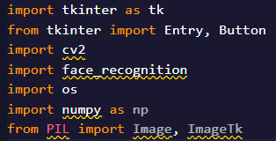
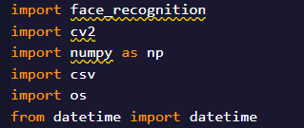
Imports
We import Tkinter to create the interface and PIL is used for image resizing and image handling
Mark_attendance_button_pressed is a function in markattendance file and execute add is a function from file newfaces both of these will be discussed later
cv2 computer vision 2 is used to process frame, show the video feed, capture the face and making it interactable with the user
OS is used here for path manipulation
numpy is used here for array manipulation and face encodings
datetime is used to handle the dates and time and to get the current date and time of the day
face_recognition is used for face detection, face encodings and it also contains pre built models making it not necessary to train the database
csv module is used to save the file in the new csv file that is easy to read

Slide 9
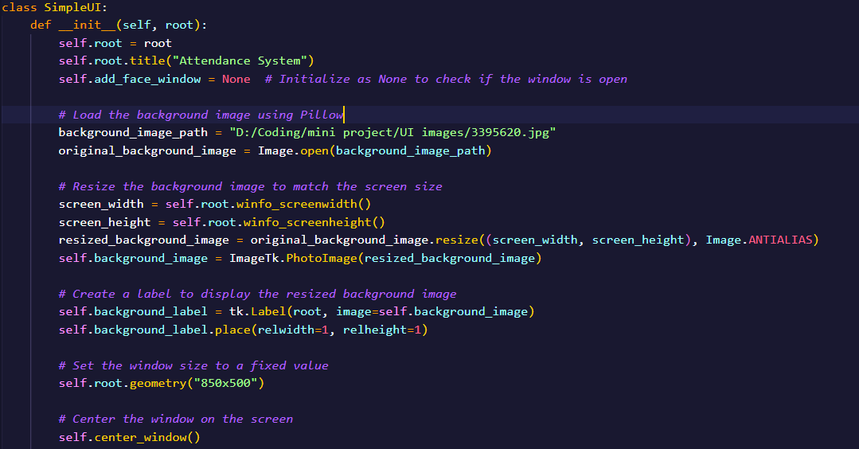
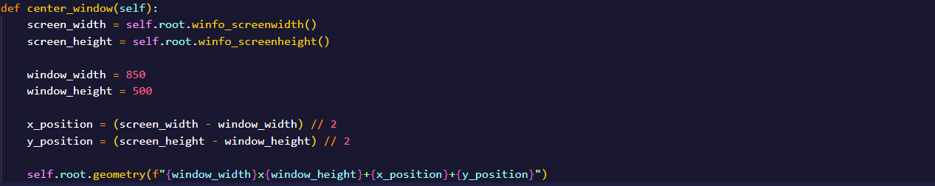
UI Design
The class SimpleUI we define contains our basic UI design with the background image and setting it’s geometry i.e., the window size and the background is also adjusted for the window
The function center_window(self) centres the window when it is opened by running the program or the executable file so it is in the centre of the screen.

Slide 10
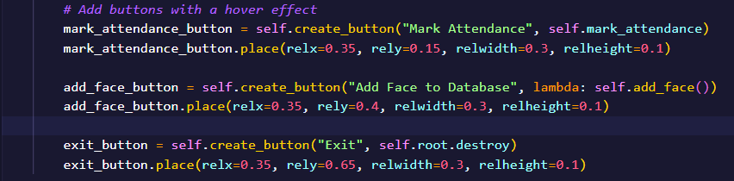
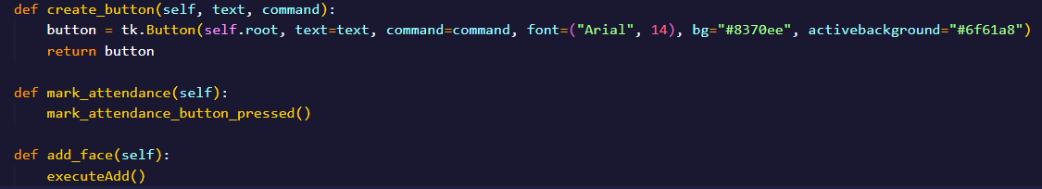
Creating Buttons and linking them with their respective commands
We create 3 buttons
Mark Attendance: executes the mark_attendance_button_pressed() from the imported file markattendance
Add Face: executes the executeAdd() from the imported file newfaces
Exit: which destroys all the windows and exits the program

Slide 11
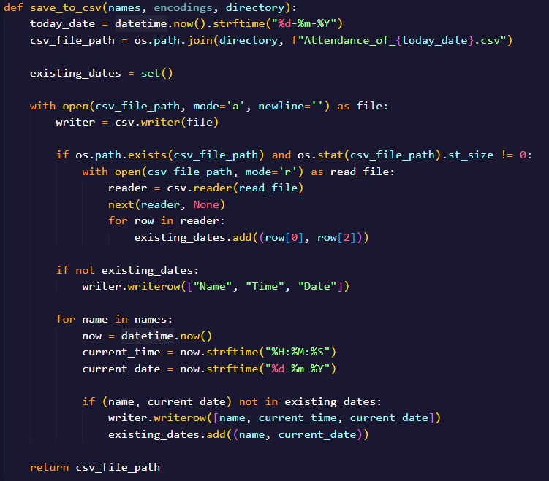
Mark Attendance Program
Save_to_csv() function
The function takes the names, encodings and the directory of where to save them as a csv file. It stores the date of the day in a variable today_date and creates a new csv file by the name “Attendance_of_{{today_date}}.csv” where the double braces gets replaced by the value of it and it stores the address of the created file in a variable csv_fille_path.
Then it opens the file it just opened in append mode and if the file is empty or was just created it will write Name, Time and Date as strings in the top row, then it will write the name it was passed as a parameter, The time of the attendance and date of that day of the next non empty row, it also checks if the name has been written on the csv file on the same day and if it is there it will not write the row.

Slide 12
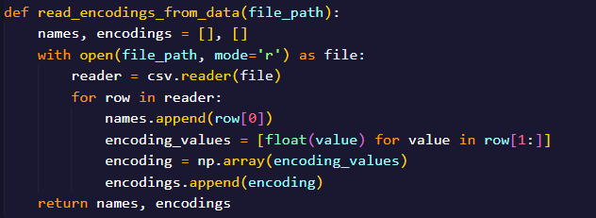
Read_encodings_from_data() function
The function takes file_path as a variable which stores the path of the file data.txt in which all the face encodings and the names have been saved.
It opens the file in the read mode and reads the file using numpy for array manipulation

Slide 13
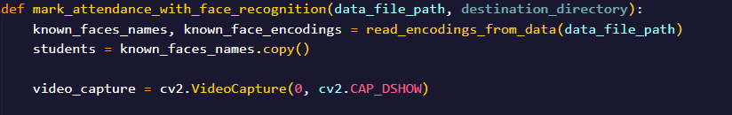
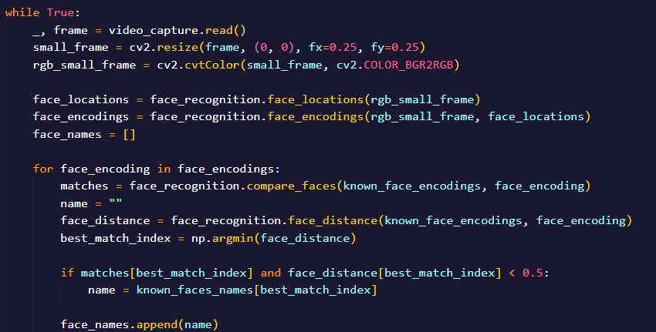
mark_attendance_with_face_recognition() function
It takes the data_file_path and destination directory as a parameter which store the path to data.txt and it then declares and initializes 2 variables known_faces_names and known_face_encodings by calling a function read_encodings_from_data(data_file_path) and another variable array which stores the names of all the student.
Then it opens a videocapture window.
Then we start an infinte loop which will keep the window open. It initializes a variable face_locations which will store the face location of each photo recognized by the video feed and same thing for encoding and it will initialize an array face_names with empty array. Then it will start a loop as long as there are face encodings in the face_encoding functions and for each encoding it will compare the faces by a face_recognition module function which will take known_face_encodings from the data.txt and face_encodings array we created and if the best match and the the face_distance which will basically tell us how similar the faces are less than 0.5 we will add the name to the array face_names.

Slide 14
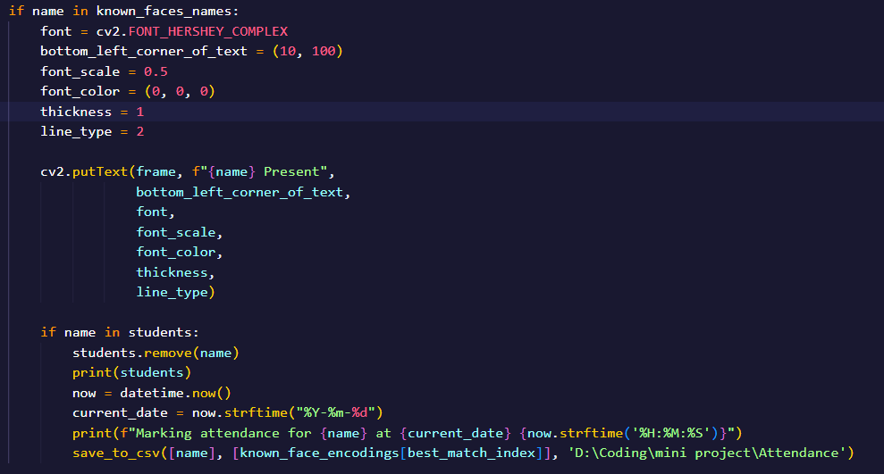

If the name is found in known_face_names we will print on the window that the person is present. And if the name is found in students we remove the name from students and we save the data to our CSV file
This part keeps the program running until ‘q’ is pressed on keyboard

Slide 15
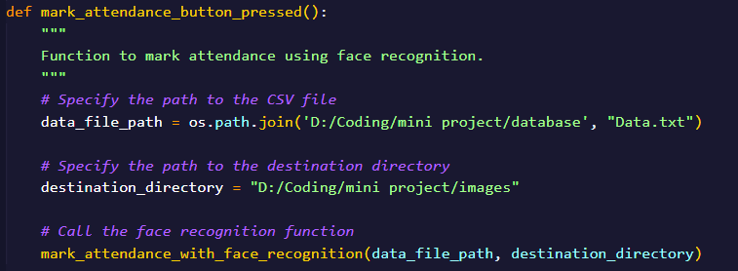
mark_attendance_button_pressed() function
This function is the one we will import and it’s basically calling every function we have defined so far in a systematic order

Slide 16
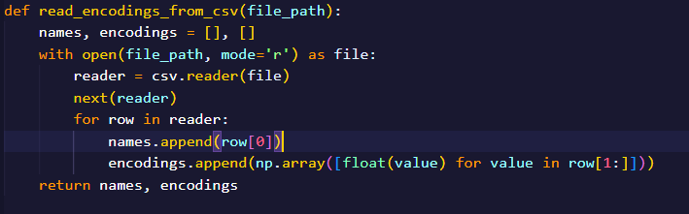
Read_encodings_from_data() function
This function takes file_path as an input and it initializes 2 arrays names and encodings with empty array it opens the file stored in the file_path in read mode and starts a loop till we can find rows with data in them and it appends the names of the data in the name array and the encodings in the encodings array from that data.txt file as it was stored in file_path

Slide 17
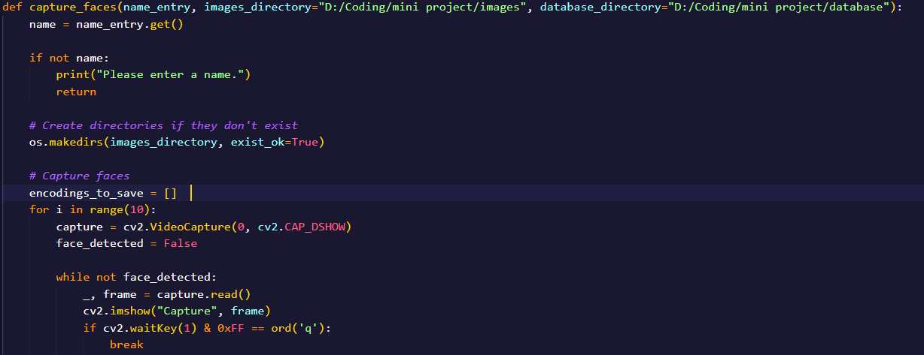
The function capture_faces() takes name_entry as an input which is basically what we enter in the entry in the tkinter entry and the image directory of image storage folder and the data.txt directory. The variable name is initialized to store the name_entry.get() which basically gets the data input in the entry and if the name is not entered print on terminal to enter a name.
If the directory for images doesn’t exist make one using os.makedirs().
Now encodings_to_save()is initialized with empty array and a loop is started
From 0 to 9 that captures 10 frames if a face is detected in the frame and quit the face capture if q is pressed

Slide 18
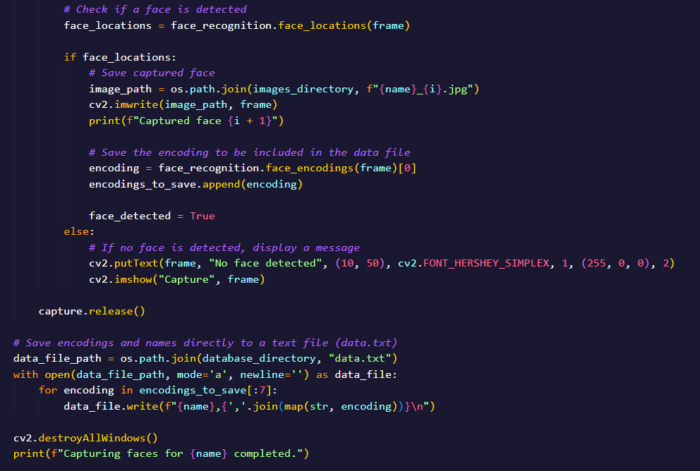
If a face is detected store the location in face_locations variable and if it’s detected store the image in the directory specified and name it with name and it’s index+1 concatenated. Now write the encodings by appending them into the array encodings_to_save.
If no face is detected a debug line is printed to make it easier for the user to understand. After 10 photos are captured release the window
Now open the file pointed by the data_file_path path in append mode and append the name and then a comma (,) and then the encoding array in map format as a string and in the end a new line escape sequence. And finally destroy all windows

Slide 19
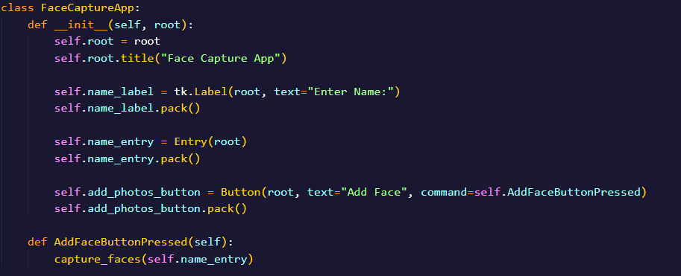
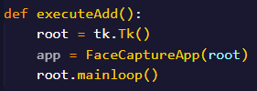
FaceCaptureApp class,AddFaceButton pressed and ExecuteAdd function
The class creates Tkinter interface which opens a new window with title “Face Capture App” and an entry that takes the name input and a button add face that will call the function AddFaceButtonPressed defined right after.
The AddFaceButtonPressed function takes self as a parameter and it calls capture_faces function passing name_entry as a parameter
The ececuteAdd() function takes no arguments and just calls the FaceCaptureApp class and starts the mainloop

Slide 20
Possible Future Updates on This Project
This project can be improved by upgrading the UI with more animations and good images
There can be added a better way to display the attendance of a student rather than opening the csv file by yourself
The add faces program can also take other student details to not just make a student attendance system but a complete student information system or an ERP portal for students
The detection of multiple faces can be done

Slide 21
Thank You For Being with me till the end

